Slide 1
Using Generative AI in Chambers
November 17, 2025

Slide 2
Panelists
Anna Blackburne-Rigsby, District of Columbia Court of Appeals
Allison H. Goddard, U.S. District Court, Southern District of California
Xavier Rodriguez, U.S. District Court, Western District of Texas
Scott U. Schlegel, Louisiana Fifth Circuit Court of Appeal
Samuel A. Thumma, Arizona Court of Appeals, Division One
Moderated by: Paul W. Grimm, District of Maryland (Ret.),
Director, Bolch Judicial Institute

Slide 3
Disclaimer
Panelists are speaking for themselves, not their respective courts.
Use of any particular GenAI tool is intended to be exemplary and not an endorsement.

Slide 4
Welcome and Framing
Paul W. Grimm District of Maryland (Ret.)
Director, Bolch Judicial Institute

Slide 5
How It Works
Samuel A. Thumma Arizona Court of Appeals, Division One

Slide 6
Terminology Matters . . . A Lot
“10 AI terms everyone should know” (I added one, so actually 11 terms)
Based on a helpful article by Susanna Ray at Microsoft, published way back on November 6, 2023. https://news.Microsoft.com/10-ai-terms/?OCID=lock2.

Slide 7
1. “Artificial Intelligence”
“[B]asically a super-smart computer system that can imitate humans in some ways.”
  Examples = comprehending what people say, making decisions, translations, and learning from experiences.
“Artificial” because “its intellect was created by humans using technology.”

Slide 8
1a. “Algorithms”
An “algorithm” is a set of instructions.
More technically, an “algorithm” is a process or set of rules that are followed in calculations or problem-solving.
A set of commands that must be followed for a computer to perform calculations.
AI systems work by putting data through “algorithms” to create models that can automate tasks.

Slide 9
2. “Machine Learning”
Field of computer science where a computer system is programmed to do something by training it to identify patterns and make predictions based on those patterns.
Data is run through algorithms, over and over, with different input and feedback each time; system learns and improves during the training.
“[L]ike practicing piano scales 10 million times in order to sight-read music going forward.”

Slide 10
3. “Large Language Models” (LLMs)
Using machine learning techniques to help process language so a computer can mimic the way humans communicate.
Training on massive amounts of text to learn patterns and relationship in language that help a computer use human words.
Can be used to translate languages, answer questions in the form of a “smart” chatbot, summarize text and write stories, poems and computer code.

Slide 11
4. “Generative AI”
Using large language models (“LLMs”) to make new things, not just regurgitate what is there already or provide information about existing things.
Learns patterns and structures and then generates new things.
Can generate text, pictures, music, videos, computer code, etc.
Can be used for the forces of good . . . or the forces of evil.

Slide 12
5. “Hallucinations”
GAI currently can’t tell whether a source it uses is real or fake, meaning it can create inaccurate responses called hallucinations.
Notorious examples are where briefs were drafted using GAI (which is not improper, with safeguards) citing fictitious authority (which is improper).
  Mata v. Avianca, Inc., No. 22-cv-1461 (PKC) (S.D.N.Y. June 22, 2023)
  Shahid v. Esaam, 2025 Ga. App. LEXIS 299 (Ga. Ct. App. June 30, 2025)
  https://www.damiencharlotin.com/hallucinations/ (comprehensive listing of hallucinations in courts worldwide)

Slide 13
6 - 10. Other AI Terms Everyone Should Know (But Not Discussed Here)
“Responsible AI”
“Multimodal Models”
“Prompts”
“Copilots”
“Plugins”

Slide 14
How Generative AI Works
(The Deeply Abridged Version)
Samuel A. Thumma Arizona Court of Appeals, Division One
(With a tip of the cap to Professor Cas Laskowski, University of Arizona James E. Rogers College of Law)

Slide 15



Historic Data
Machine Learning Algorithm
Predictive Model

Slide 16

New Data
Predictive
Model
Prediction

Slide 17
Deepfakes v. Hallucinations (in two phrases, in the legal context)
Samuel A. Thumma Arizona Court of Appeals, Division One

Slide 18
Deepfake = manipulated media offered as legitimate media
Hallucination = made-up legal authority

Slide 19
Some Risks of Using Generative AI
  Bias – Absent corrective measures, GAI produces content that is as biased as the data in the LLMs/train with.
  Mindless parroting – Output is only as good as training input.
  Hallucinations
  Black box process – Decisions are opaque and not explainable in the “show me the math” sort of way. State v. Loomis, 881 N.W.2d 749 (Wis. 2016) (COMPAS risk tool).
  Not necessarily aligned with human values – GAI lacks the capacity to model consequences or ethical implications of decisions.

Slide 20
Some Risks of Using Generative AI
  Copyright and intellectual property infringement concerns.
  Cost to train – Sam Altman, CEO of OpenAI, confirmed that GPT-4 cost more than $100 million to train.
  Cost to operate – ChatGPT’s daily queries estimated to cost as much as powering 33,000 households in the U.S.
  Static – Concern that GAI AI models cannot update their knowledge in real-time or generate new ideas, which may lead to misinformation.
  Employment/workplace policies.
Katie Jones, 9 Problems with Generative AI, in One Chart (November 20, 2023)
https://www.visualcapitalist.com/sp/9-problems-with-generative-ai-in-one-chart/

Slide 21
Guardrails for Responsible Use of AI
Allison H. Goddard, U.S. District Court, Southern District of California
Scott U. Schlegel, Louisiana Fifth Circuit Court of Appeal
Xavier Rodriguez, U.S. District Court, Western District of Texas

Slide 22
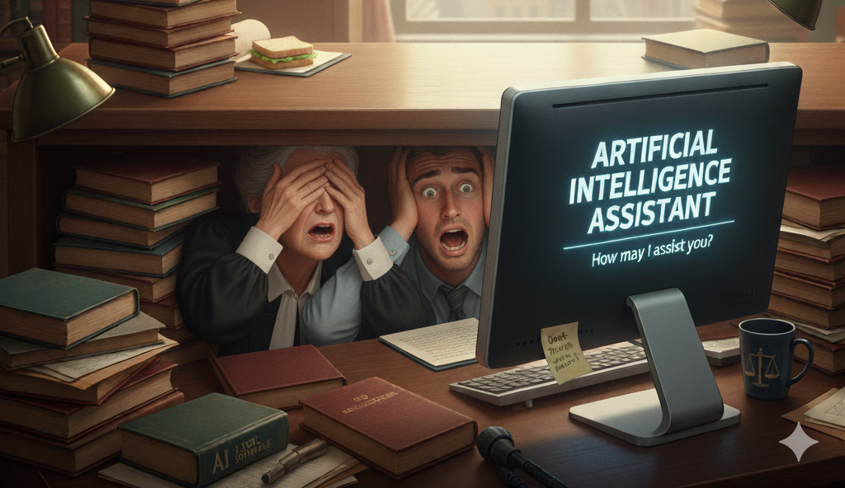

Slide 23
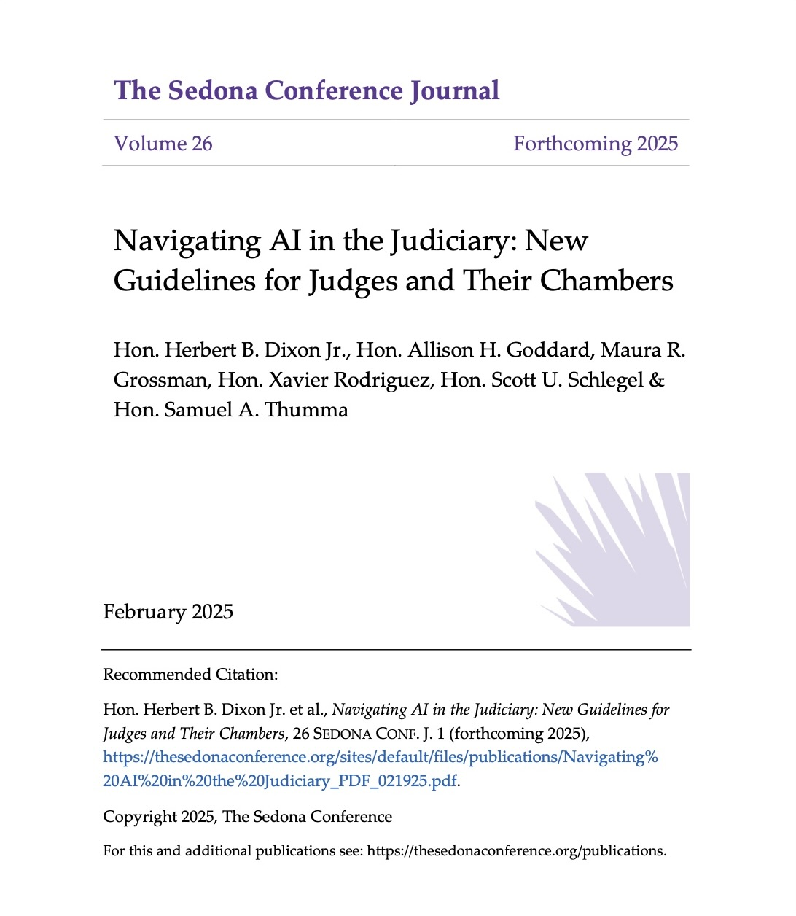

Slide 24

Navigating AI In The Judiciary: Fundamental Principles
Maintain Judicial Authority: AI assists but cannot replace human judgment
Verification is Essential: All AI outputs require human verification
Confidentiality & Security: Protect sensitive court information
Understand Limitations: Recognize bias, hallucinations, and reliability issues

Slide 25

What could possibly go wrong?

Slide 26
Legitimacy of the Courts
If people start believing that judicial opinions are filled with fake law or were written by machines, we don’t just lose credibility. We lose legitimacy.
State - First Known Case
Trial court’s divorce order relied on fake case citations
Husband’s attorney submitted a motion citing nonexistent cases
Appellate court vacated the order as “void on its face”
Federal – Sen. Grassley
Judge’s opinion included quotes and citations that did not exist
Judges submitted letters of explanation to the Senate Judiciary Commission

Slide 27
Other Potential Issues
Missing hallucinated information in parties’ briefs
Mission creep – using a GenAI tool for a purpose outside its effective scope
Confidentiality – risk of disclosing confidential information
Information security – exposing court IT system to bad actors
Complacency – the better it gets, the less vigilant you may be

Slide 28
From Principles to Actions
Written Policy for Use of AI Tools in Chambers
Conversations with law clerks, law student interns/externs
Familiarity with AI Tools and Terms of Service

Slide 29
Written Policy
Prior approval of any GenAI tool used for work
No uploading information that has been sealed or redacted from the public court docket
Clerks and externs must check all draft memos or orders for hallucinations before submitting to judge for review.
Use of GenAI tools must comply with any other applicable court rules and policies.
GenAI tools are designed to assist, not replace, human judgment. Human oversight is required at every step of work.

Slide 30
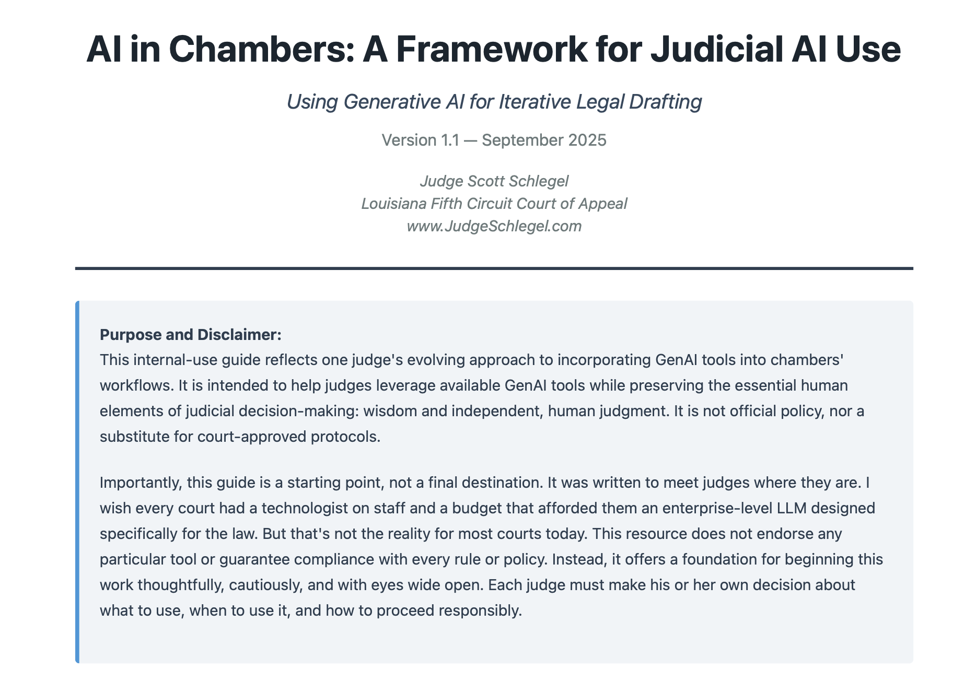

Slide 31
Best Practices – Nonpublic Information
The Court may use AI tools to review the information that the parties submit. Either party may object to the Court’s use of such tools by advising the Court’s clerk of that objection when they submit the information. The Court will respect that objection without any further explanation, and the Court’s clerk will only communicate to Judge Goddard that there was an objection, not which party made the objection.

Slide 32
Mistakes We See Judges Make
Standing Orders
Not using AI tools like QuickCheck
Mission Creep

Slide 33
Show and Tell
Allison H. Goddard, U.S. District Court, Southern District of California
Xavier Rodriguez, U.S. District Court, Western District of Texas
Scott U. Schlegel, Louisiana Fifth Circuit Court of Appeal

Slide 34
Preventing Hallucinations in Court Orders
“A basic prerequisite to the filing of any pleading, motion, response, reply, or paper in court is for the drafting and filing attorney(s) to carefully check every case citation, fact, and argument to make sure that they are correct and proper.”
Versant Funding v. Teras Breakbulk Ocean (S.D. Fla. May 20, 2025) (Matthewman, M.J.)

Slide 35
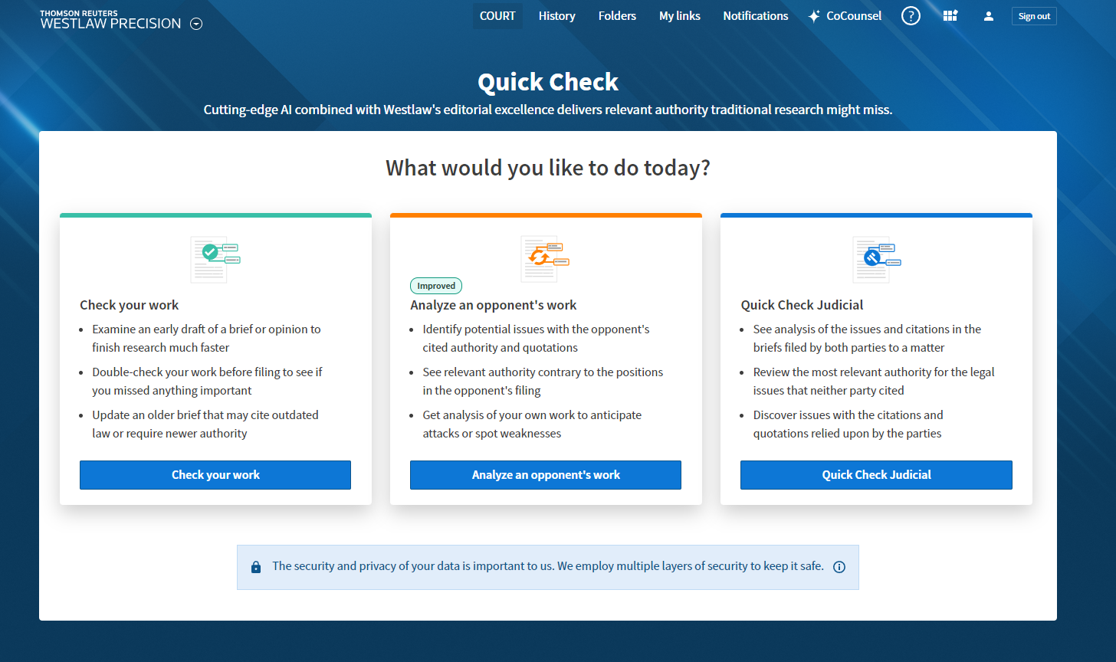

Slide 36
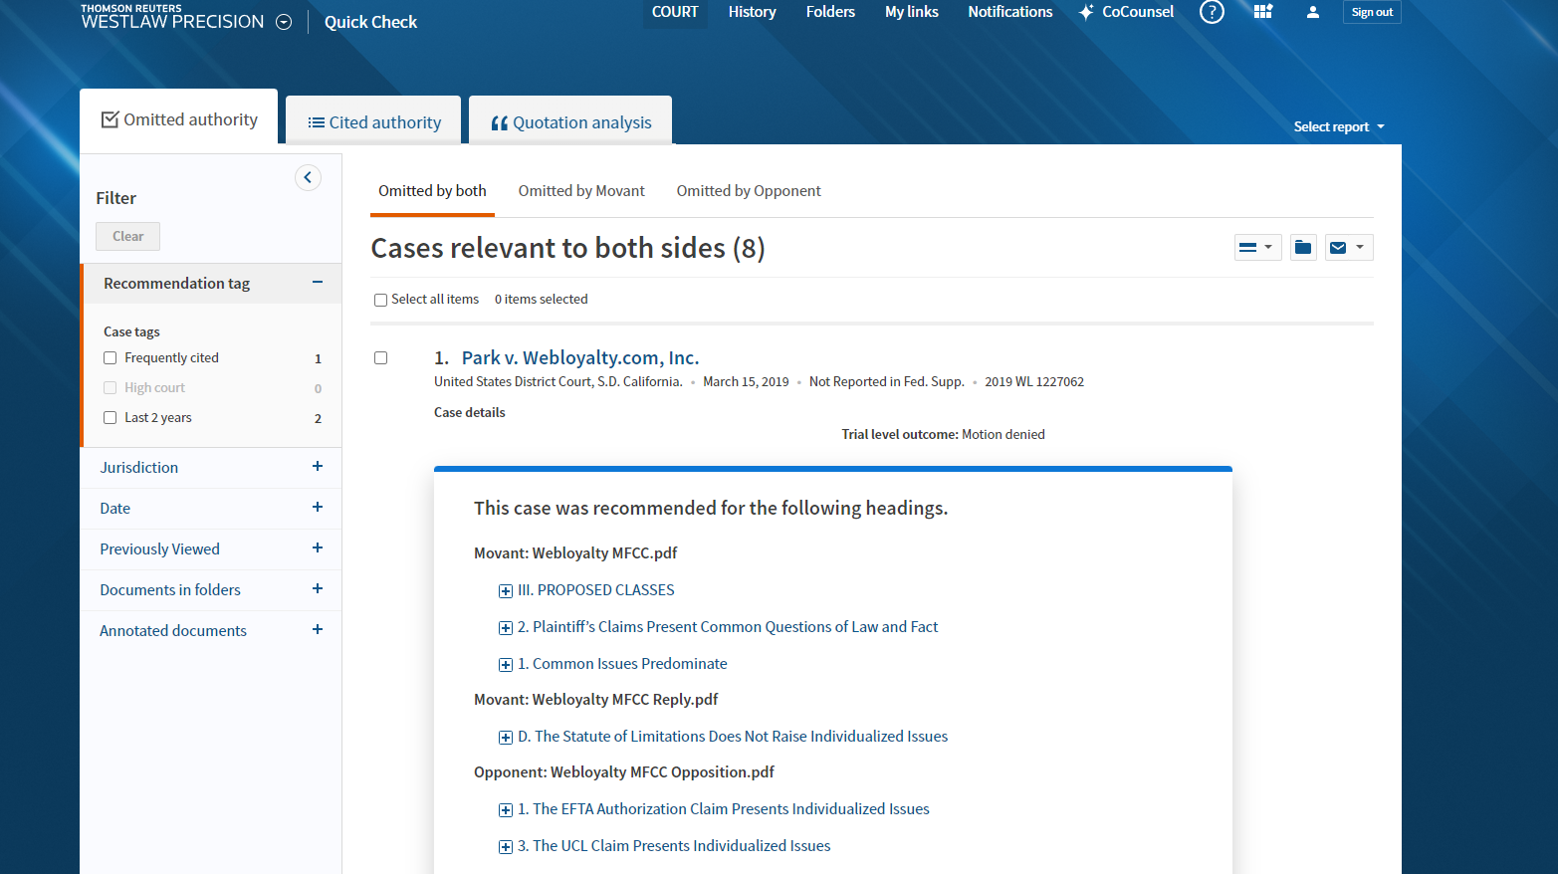

Slide 37
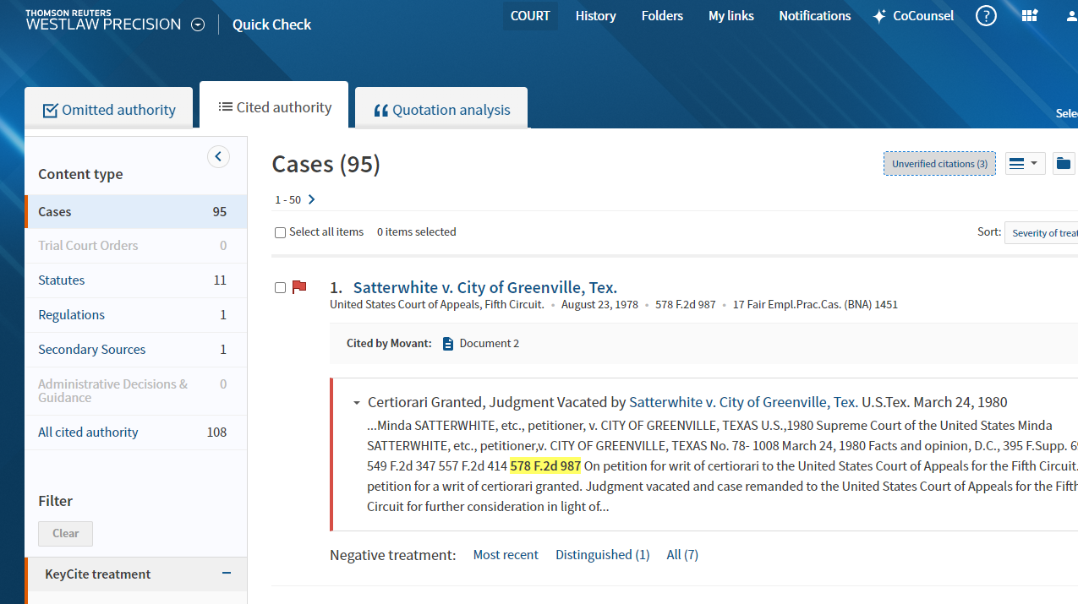

Slide 38
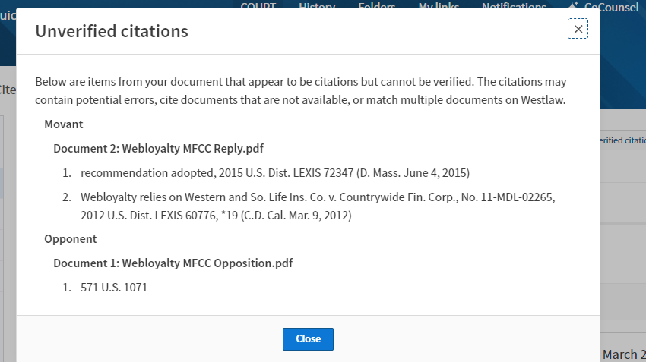

Slide 39
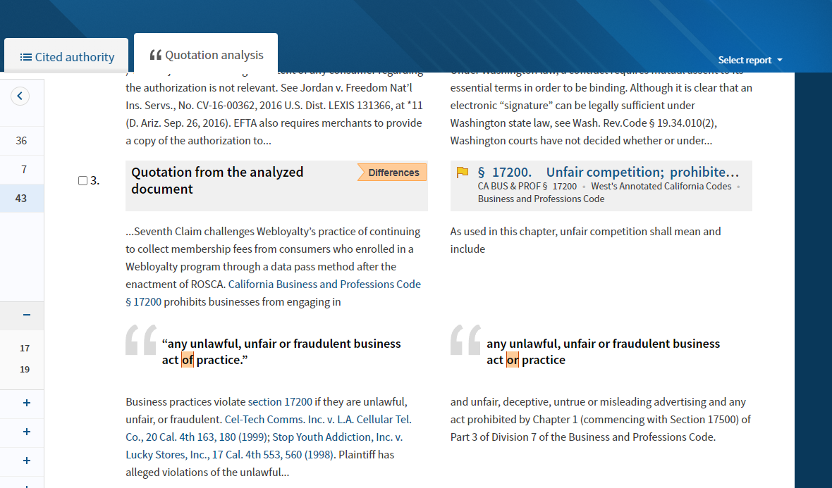

Slide 40
Building a Case Overview
Summarize case-related documents
Build a timeline/chronology
Identify key facts

Slide 41
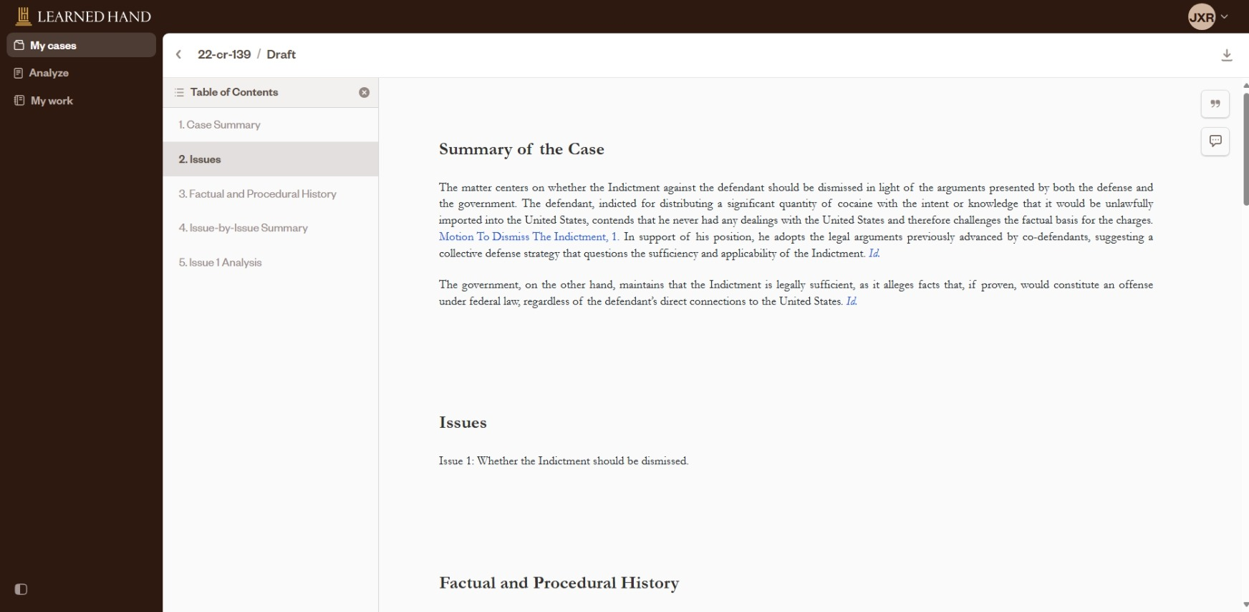

Slide 42
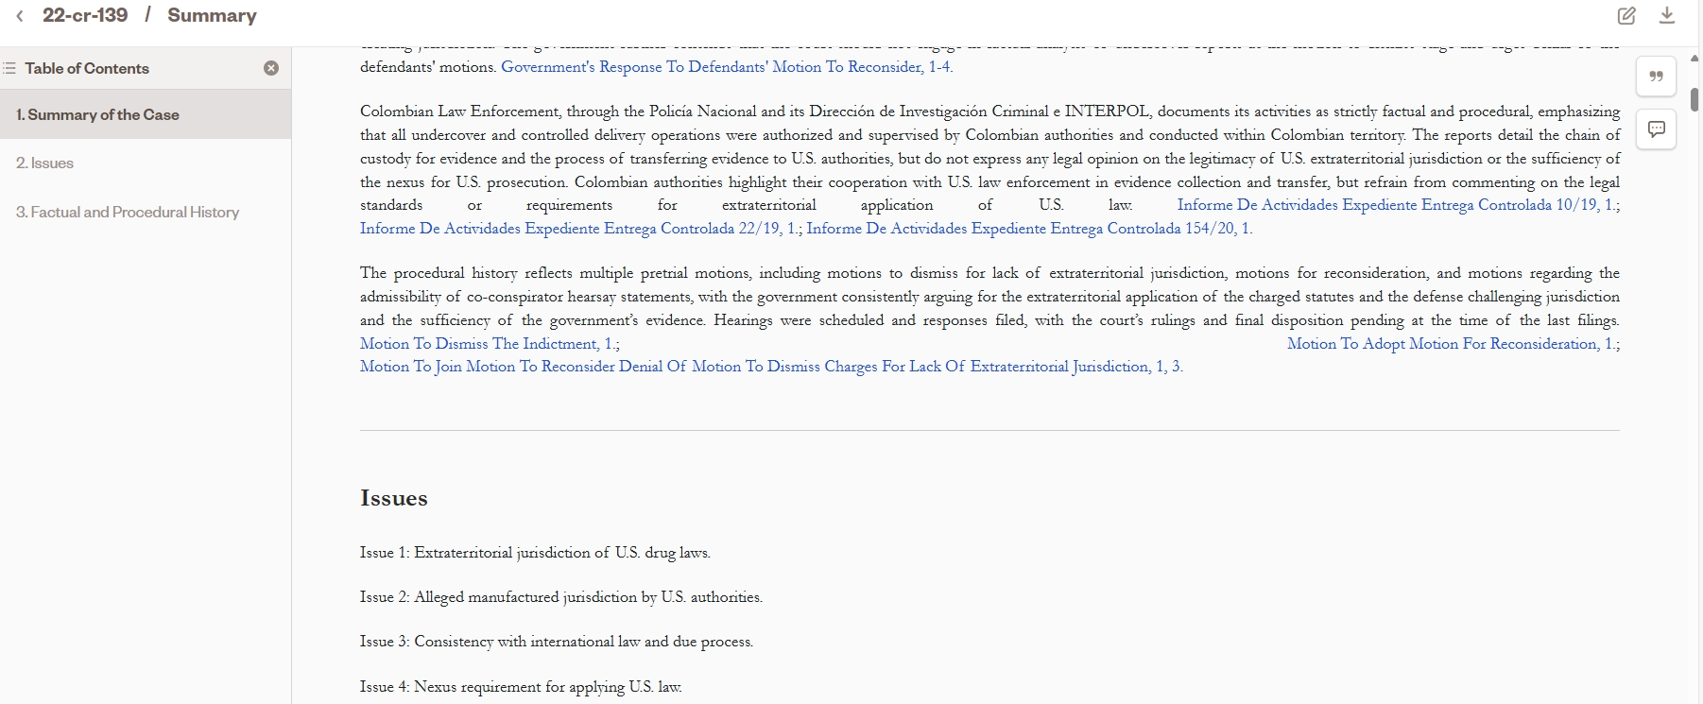

Slide 43
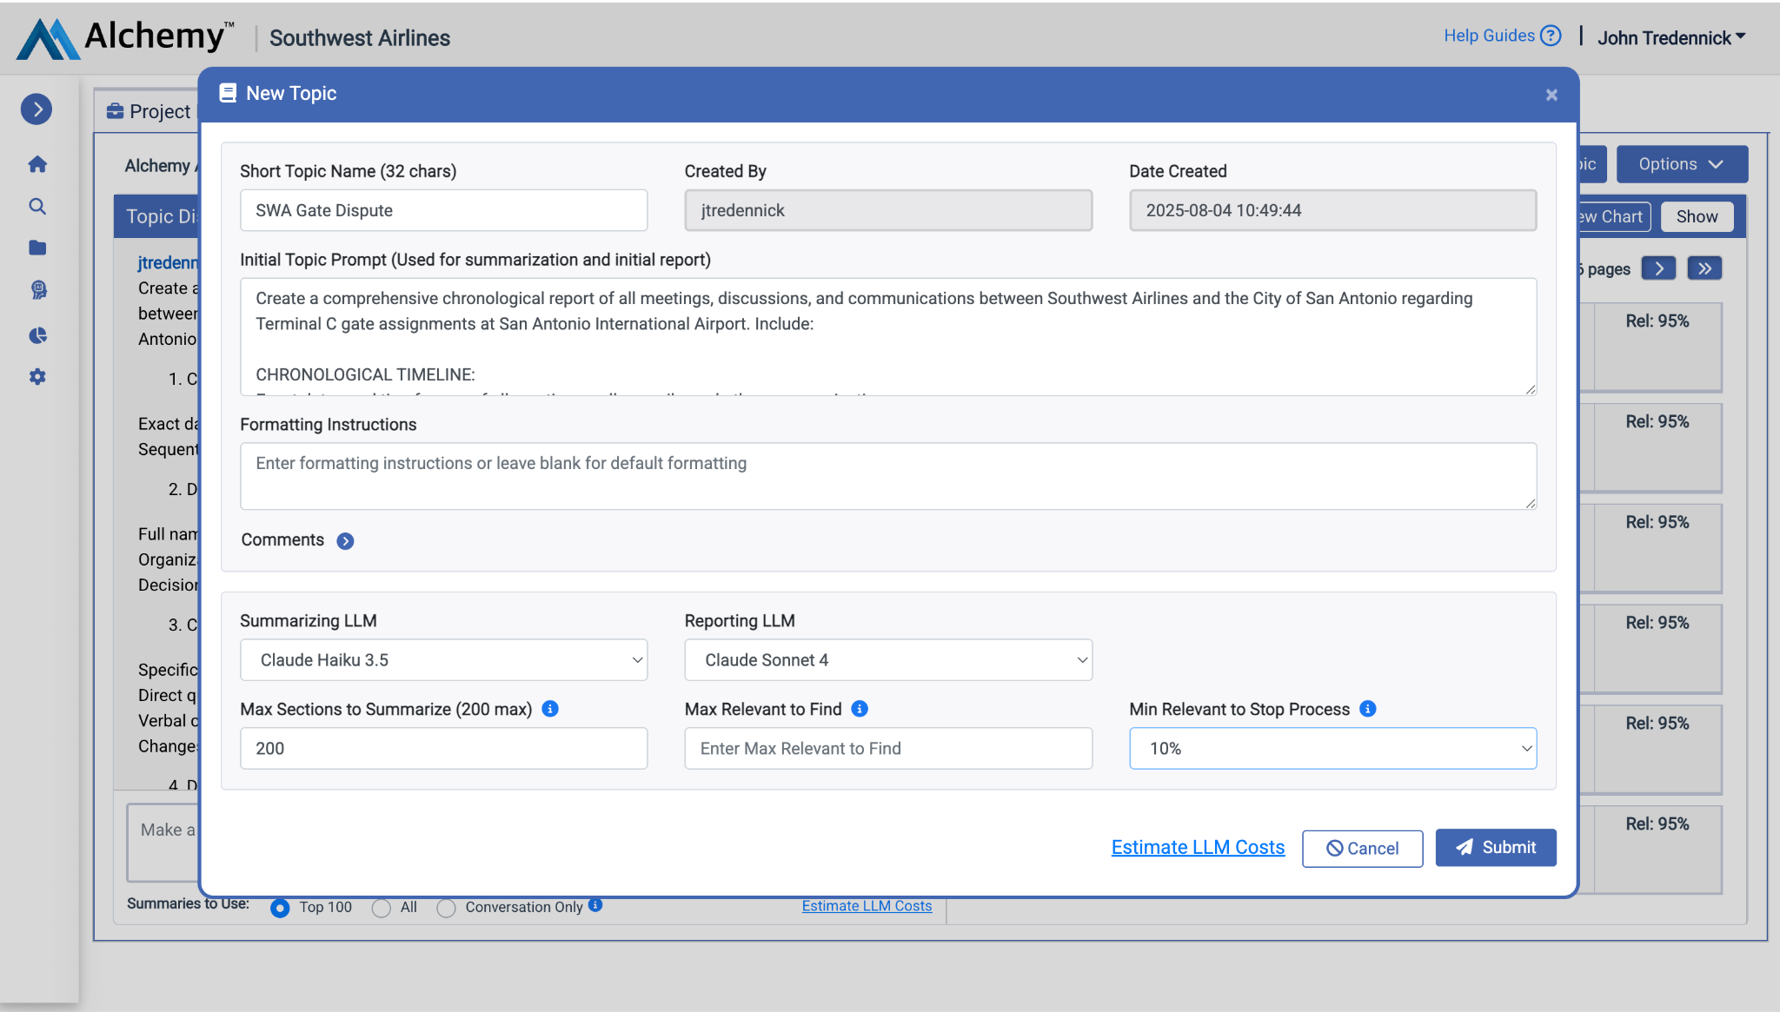

Slide 44
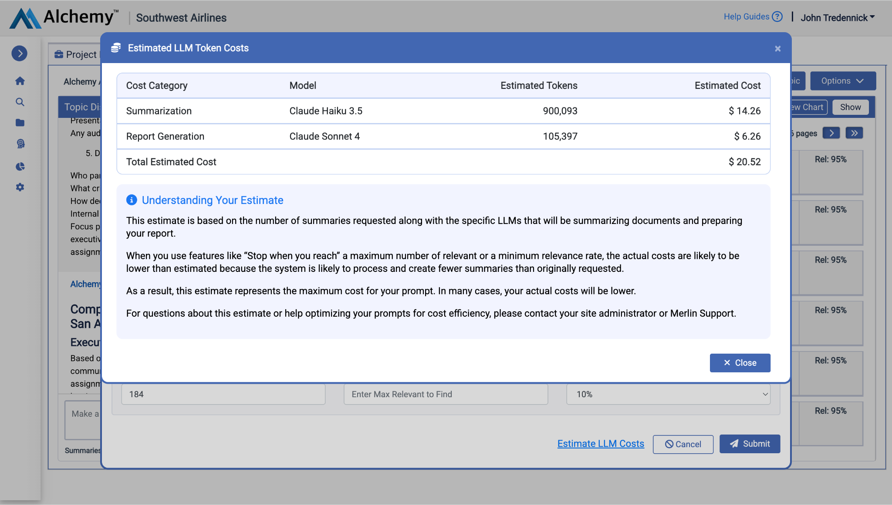

Slide 45
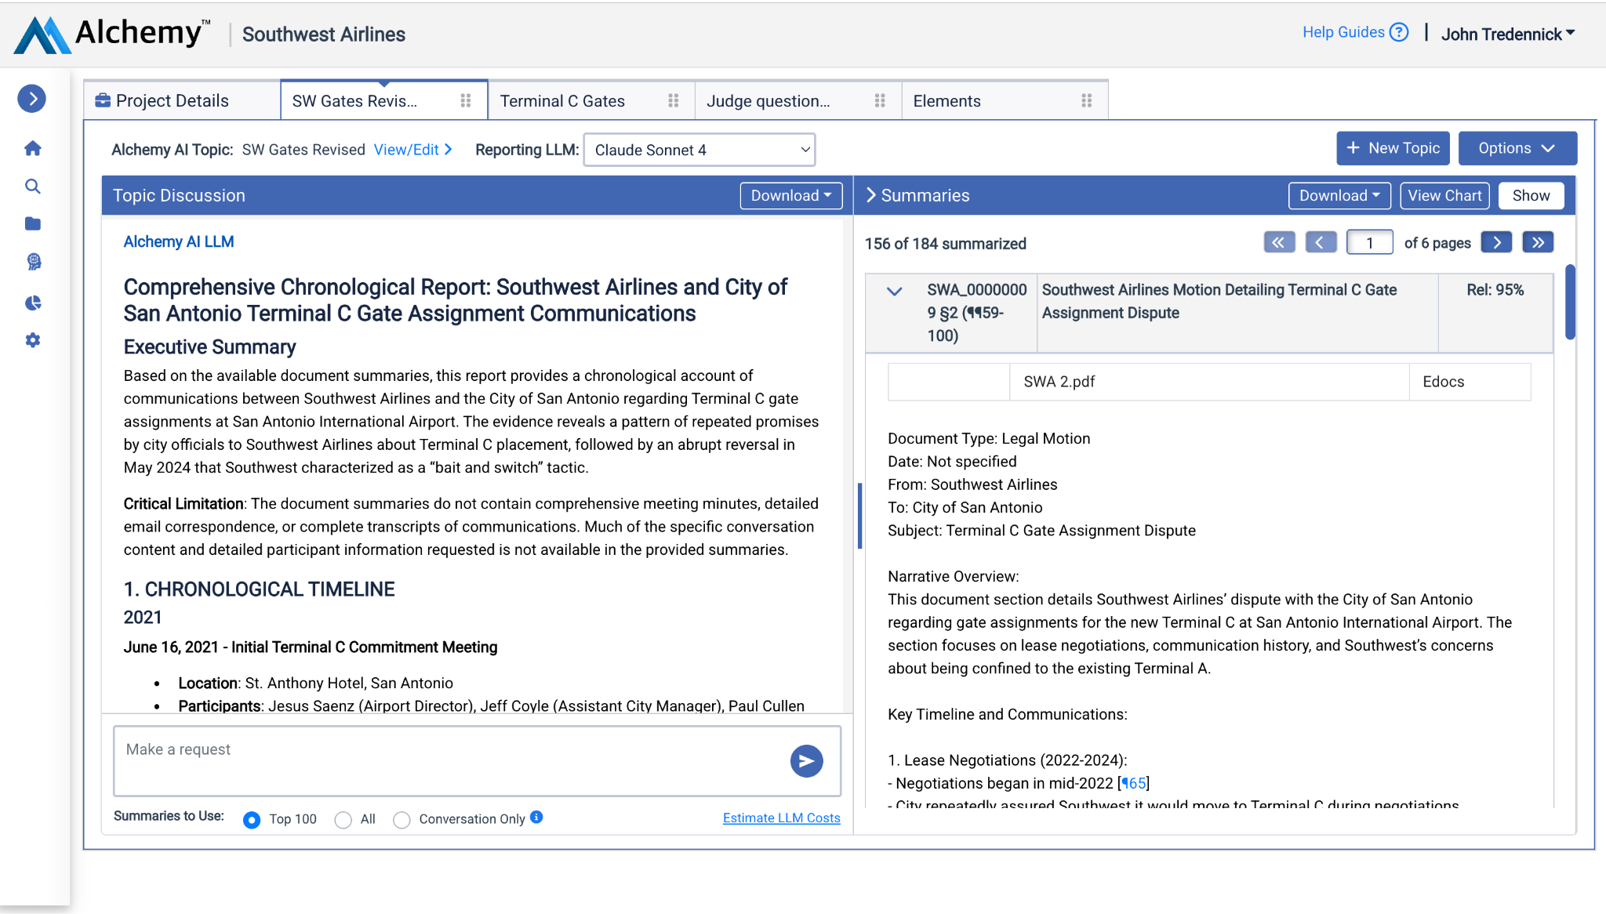

Slide 46
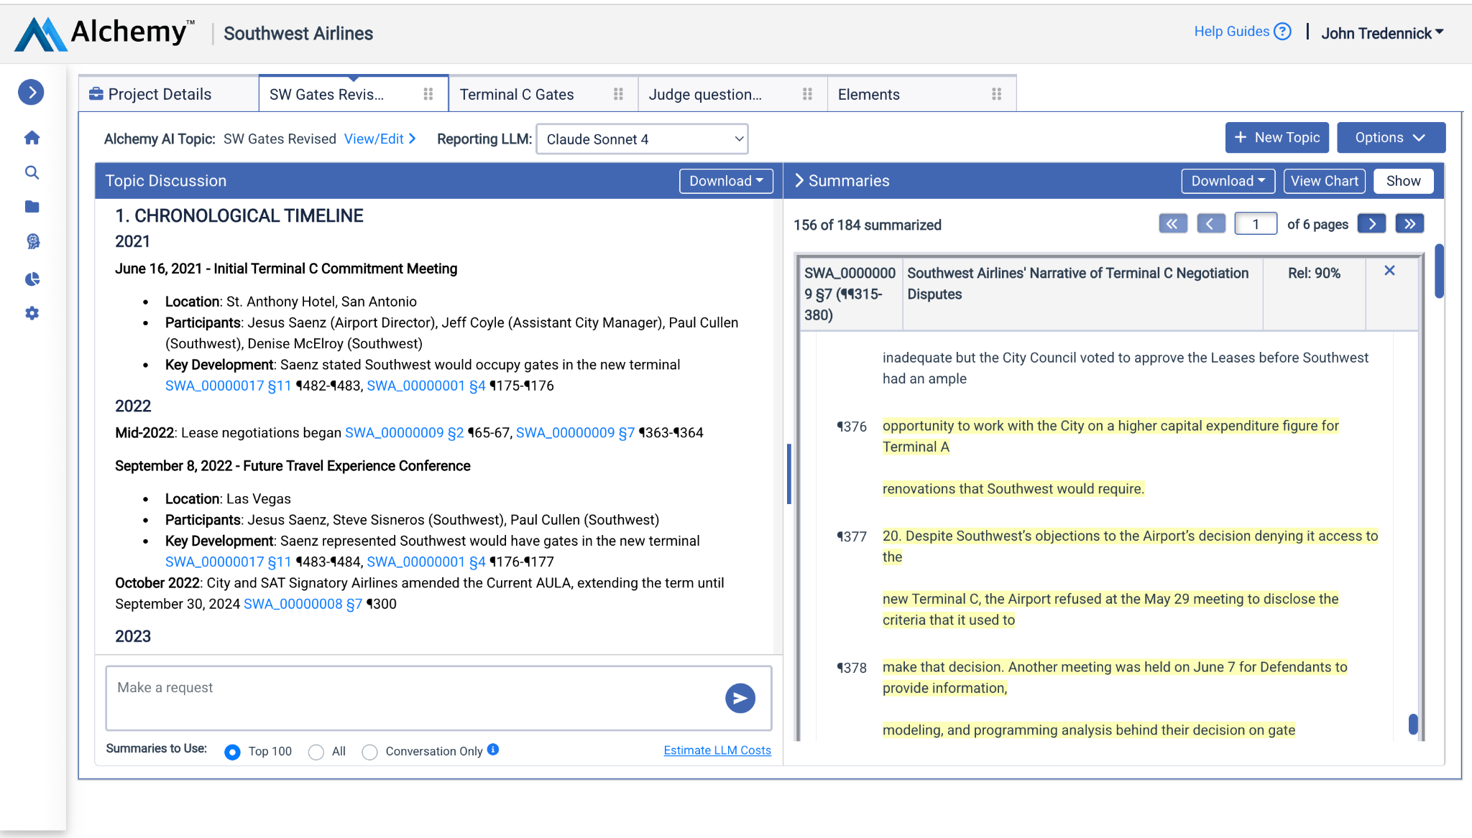

Slide 47
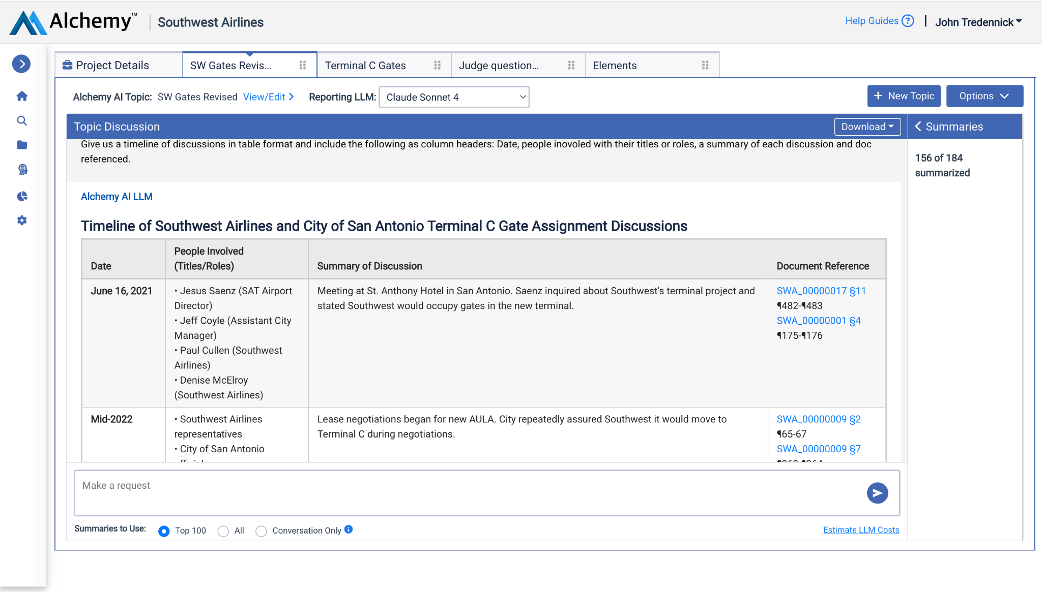

Slide 48
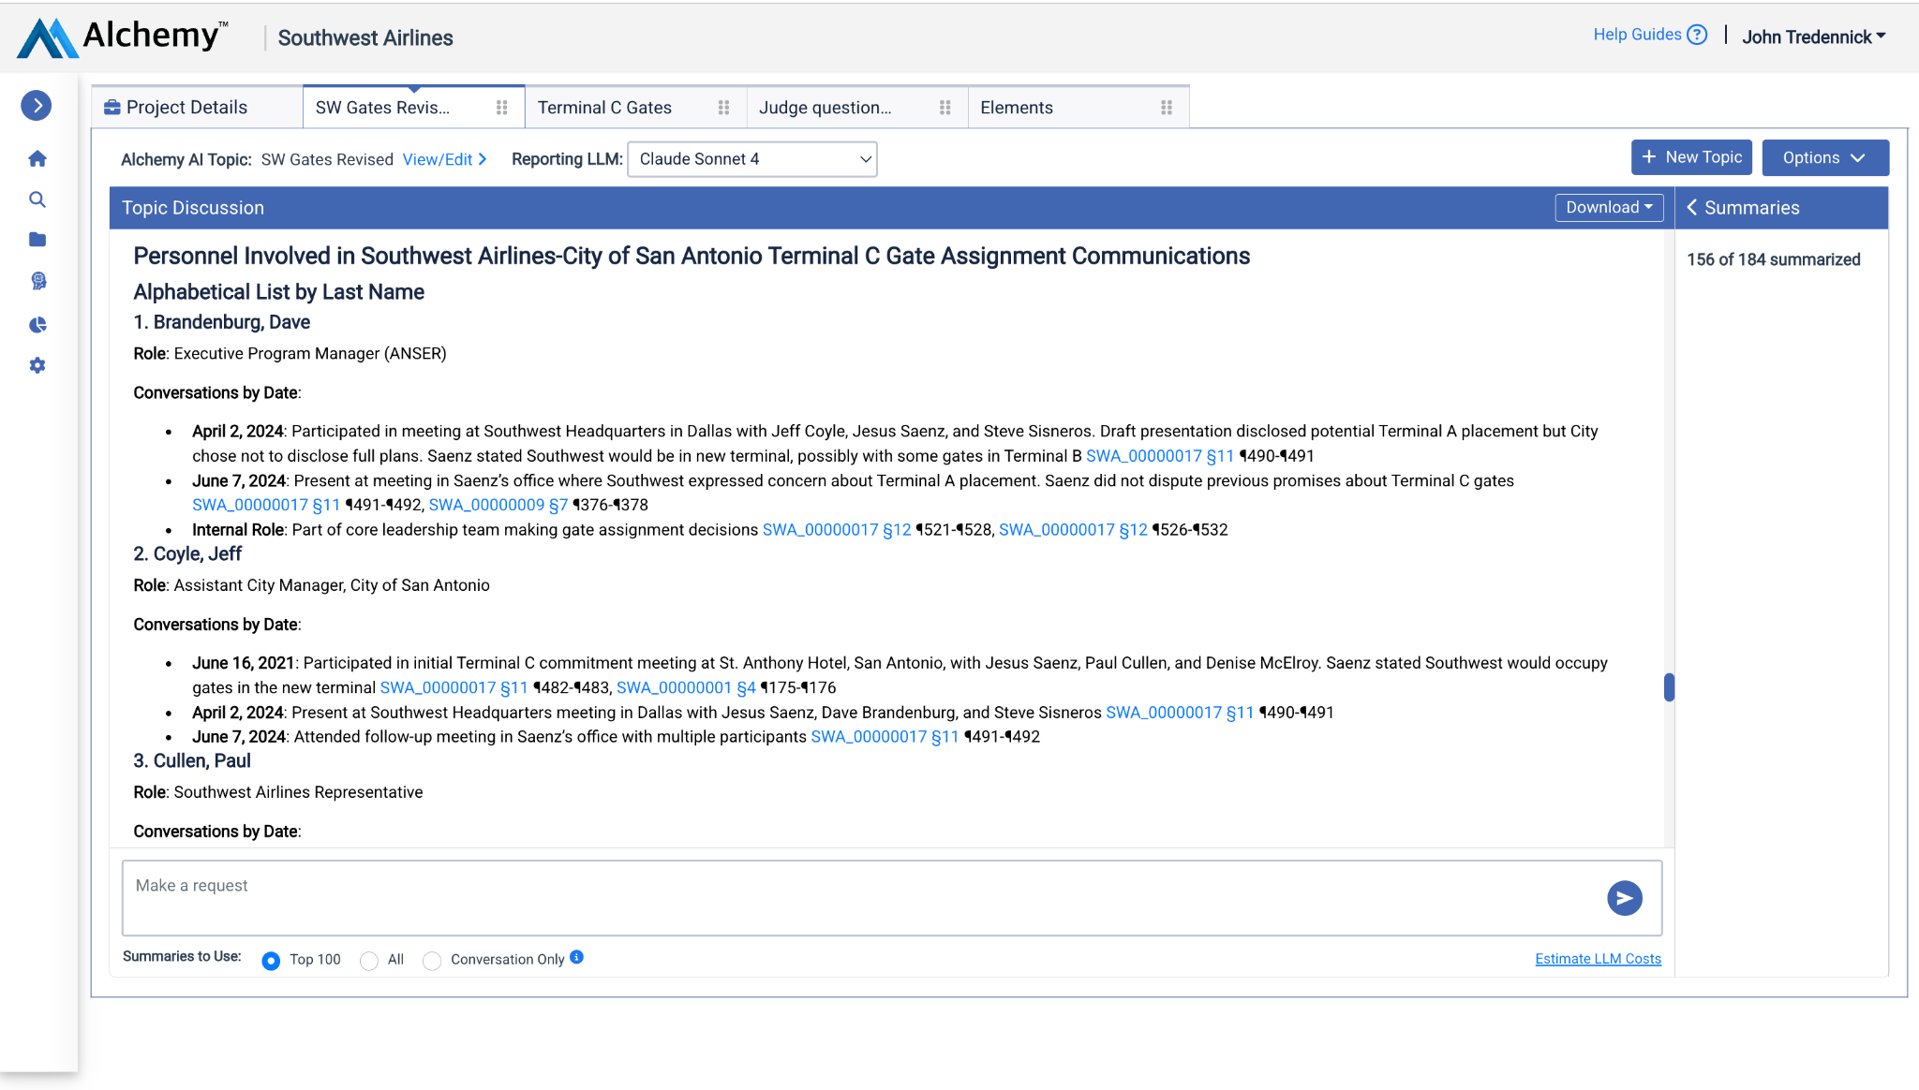

Slide 49
Drafting Assistance
Prompting against a collection of prior orders
Hyper-thesaurus
Suggesting edits

Slide 50
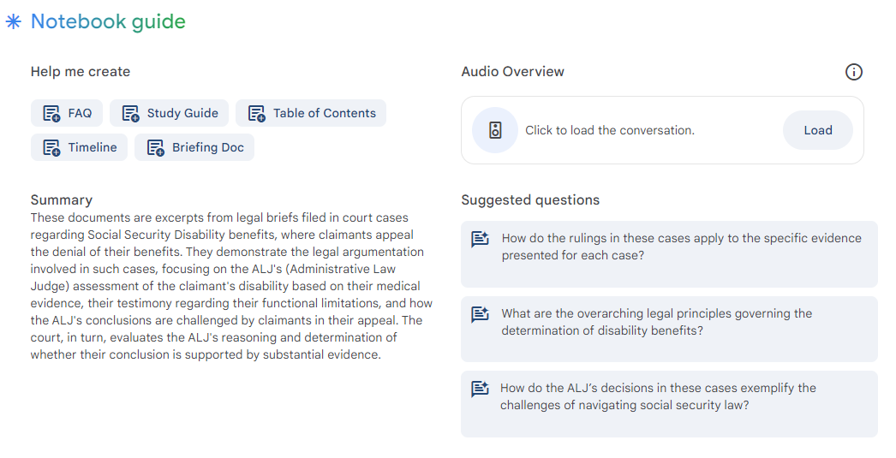

Slide 51
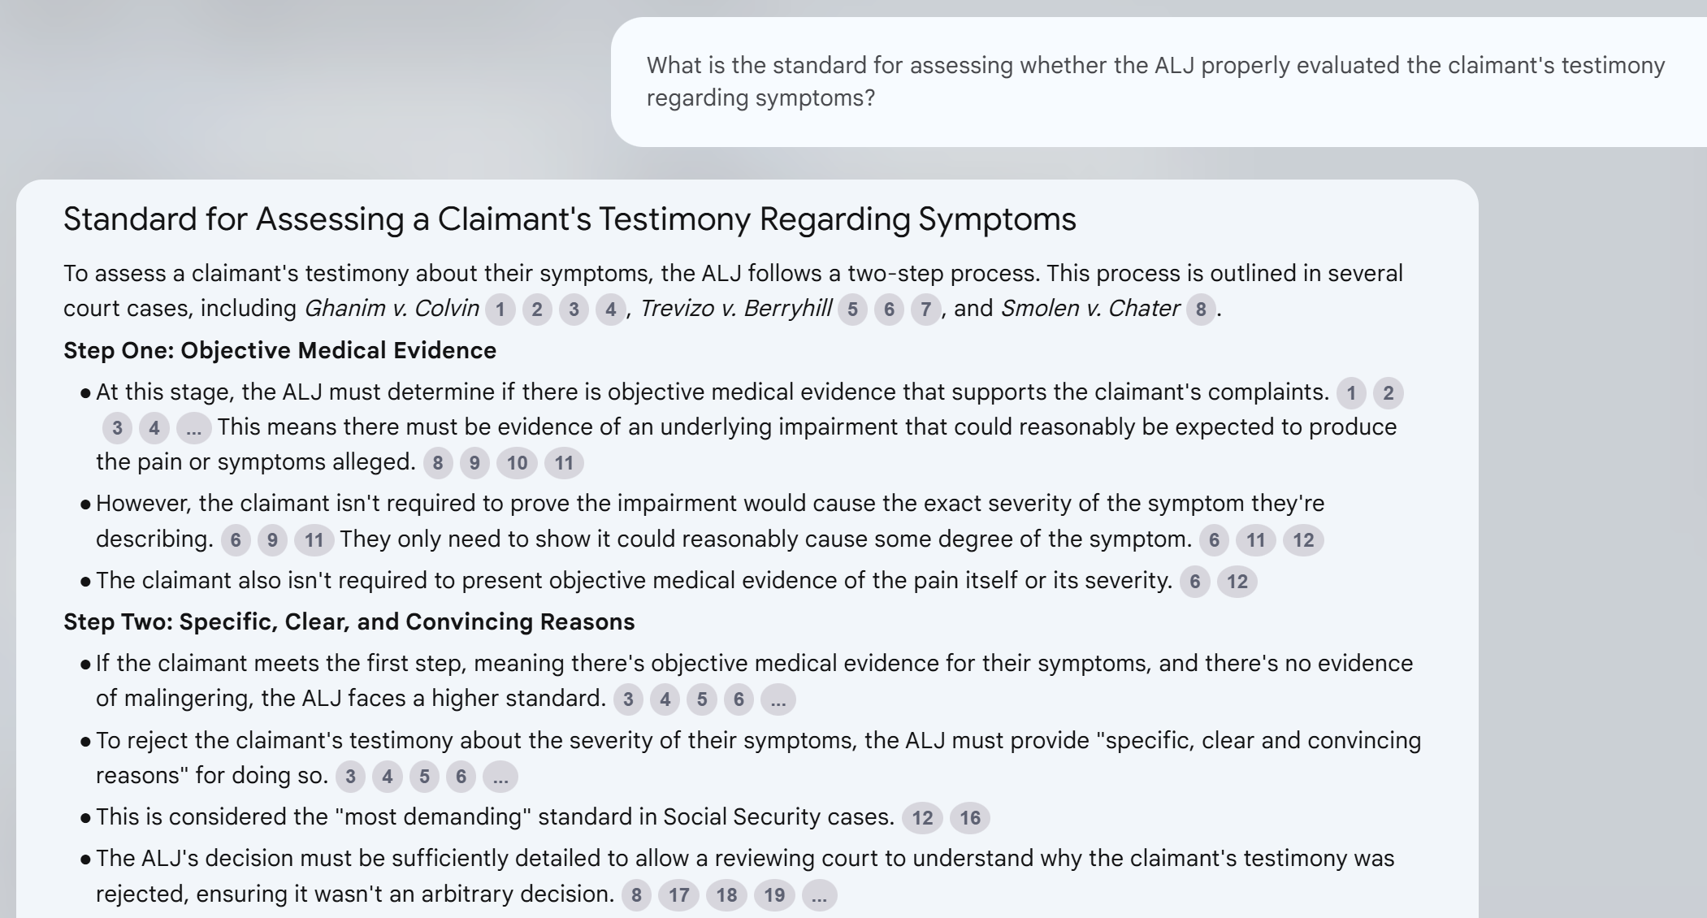

Slide 52
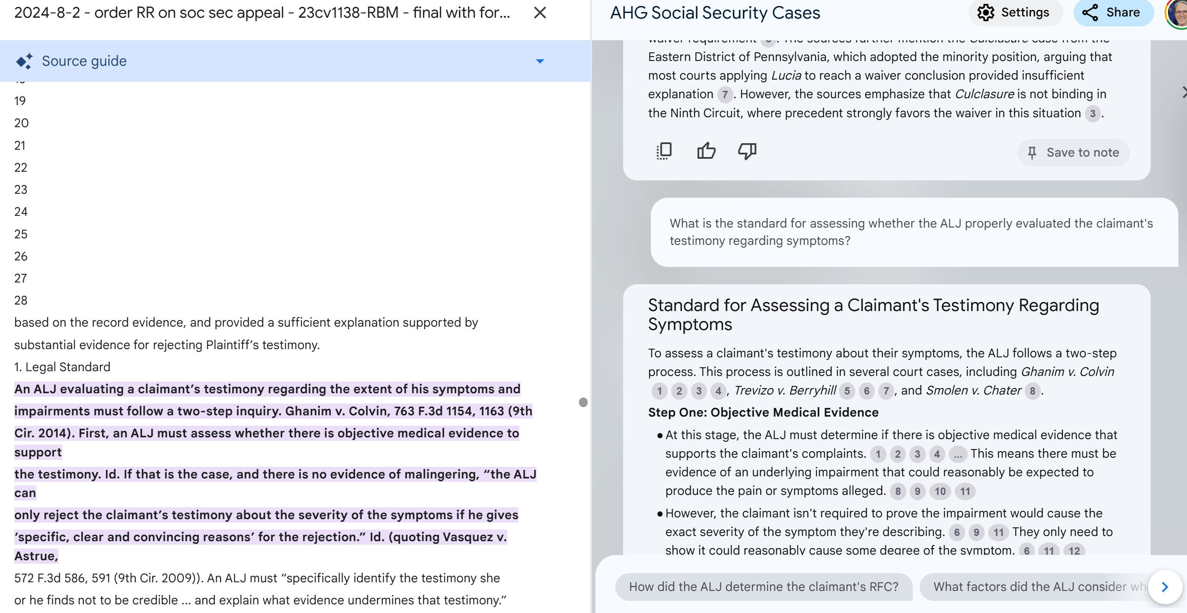

Slide 53
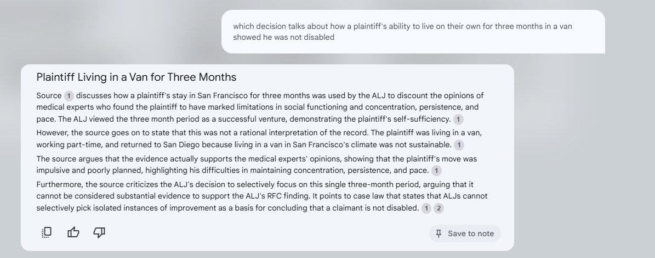

Slide 54
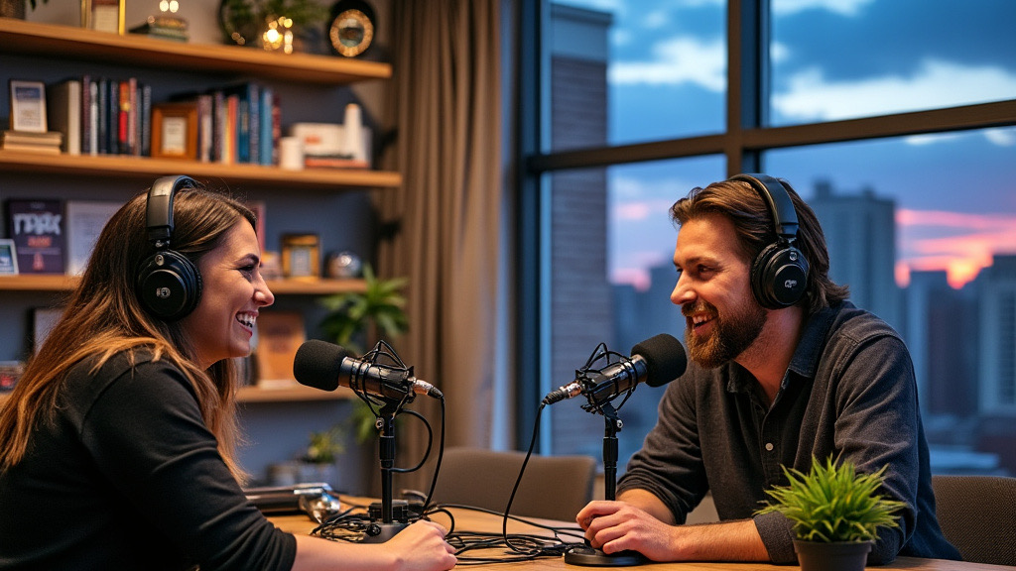

Google NotebookLM - Audio Overview

Slide 55
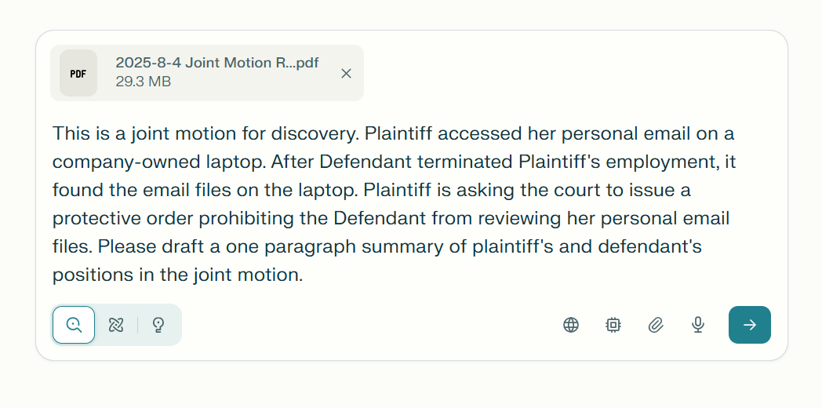

Slide 56
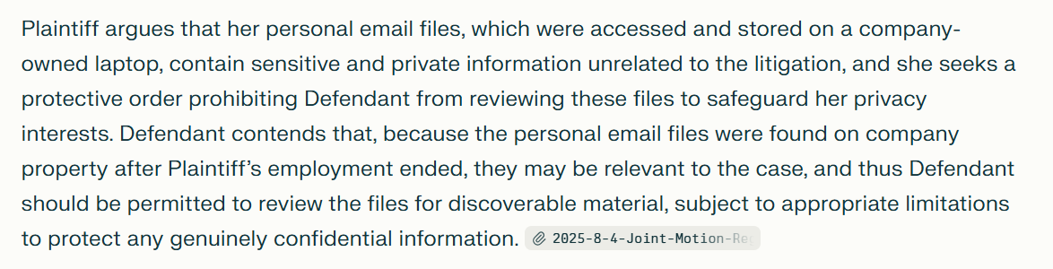

Slide 57
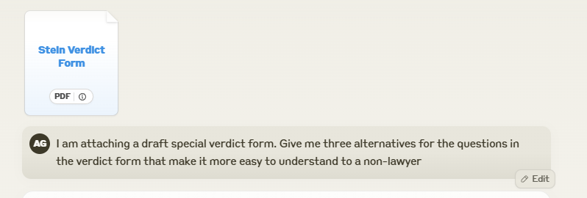

Slide 58
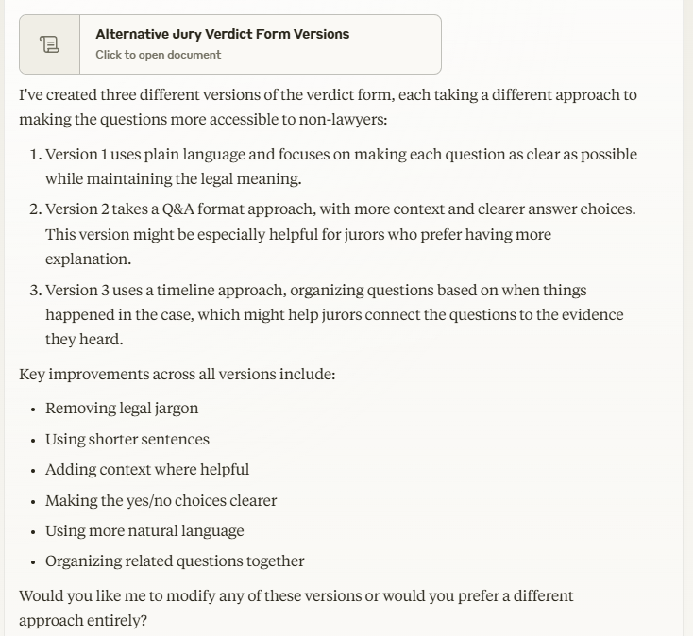

Slide 59
Responsible Uses of AI in Chambers
Administrative (performance reviews, letters of recommendation)
Case-related (drafting assistance, research using legal tools, summarization, chronologies, hearing preparation)

Slide 60
Ethics Mini-Module with Hypothetical
Anna Blackburne-Rigsby District of Columbia Court of Appeals

Slide 61
Ethical Duty
Competence in technology is an ethical requirement for both lawyers and judges
  Model Rule of Professional Conduct 1.1, Comment 8
  Model Code of Judicial Conduct 2.5
Understand the levels of risk of AI tools
Human oversight
Accuracy and verification
Transparency and community support
Fairness and bias

Slide 62
Ethical Considerations for Judges
Ex Parte Communications (Model Code of Judicial Conduct 2.9)
Confidentiality and Privacy
Impartiality and Fairness (MCJC 2.2)
Bias, Prejudice, and Harassment (MCJC 2.3)
Duty to Supervise (MCJC 2.12)
Hiring and Administrative Appointments (MCJC 2.13)
Responsibility to Decide (MCJC 2.7)

Slide 63
Ethical Considerations for Attorneys
Responsibilities of a partner or supervisory lawyer
(Model Rule of Professional Conduct 5.1)
Confidentiality and privacy (MRPC 1.6)
Hiring
Fees (MRPC 1.5)
Communication, transparency and candor (MRPC 1.4, 3.3)
Misconduct (MRPC 8.4)

Slide 64
D.C. Courts AI Task Force & Use Policy
The D.C. Courts created an AI Task Force to study AI use in the Courts.
Possible uses include:
Helping with scheduling and managing tasks
Chatbots to share helpful information with litigants
Hiding private or sensitive information in documents automatically
Helping staff see patterns or trends in the types of cases being filed
Helping process payment orders more quickly and accurately
Reducing repetitive manual work
Importantly, the Task Force clarifies that judges are not using AI to write opinions or make decisions.

Slide 65
Use Case #1
A judge or law clerk needs to draft an opinion in a difficult case, one in which the judge is not completely decided.
The judge or law clerk uses ChatGPT to draft the opinion.
Is this an ethical use? Why or why not?

Slide 66
Use Case #2
An attorney is representing a party in a domestic case in which their client brings them a recording of their partner threatening their children.
Is it possible AI was used to create or alter the recording?
What is the attorney’s ethical obligation in representing their client?
What is the judge’s ethical obligation? Does it matter if the other party is unrepresented?

Slide 67
Use Case #3
A vendor brings a product that uses AI to predict recidivism for individuals. The method used is proprietary.
Is this an ethical use? Why or why not?

Slide 68
Resources
https://www.ncsc.org/__data/assets/pdf_file/0010/101125/ncsc-ai-rrt-judicial-legal-ethics-may-2024.pdf
https://www.ncsc.org/__data/assets/pdf_file/0017/110168/Principles-and-Practices-for-AI-in-State-Courts.pdf
https://aisandbox.ncsc.org/login?_gl=1*vp65le*_ga*MTU5MjI0NDEuMTczOTIwMDM5MQ..*_ga_HB58441DGF*MTc0NDM5MDA0NC4xMC4wLjE3NDQzOTAwNDQuMC4wLjA (NCSC AI Sandbox)
https://www.dccourts.gov/about/courts-and-ai (DC Courts AI Task Force & Use Policy)

Slide 69
Q&A
Submit your questions using the Q&A function at the bottom of your screen.

Slide 70




Thanks For Watching
www.ali.org
https://judicialstudies.duke.edu/
ali@ali.org
bolchjudicialinstitute@law.duke.edu

